Slide 1
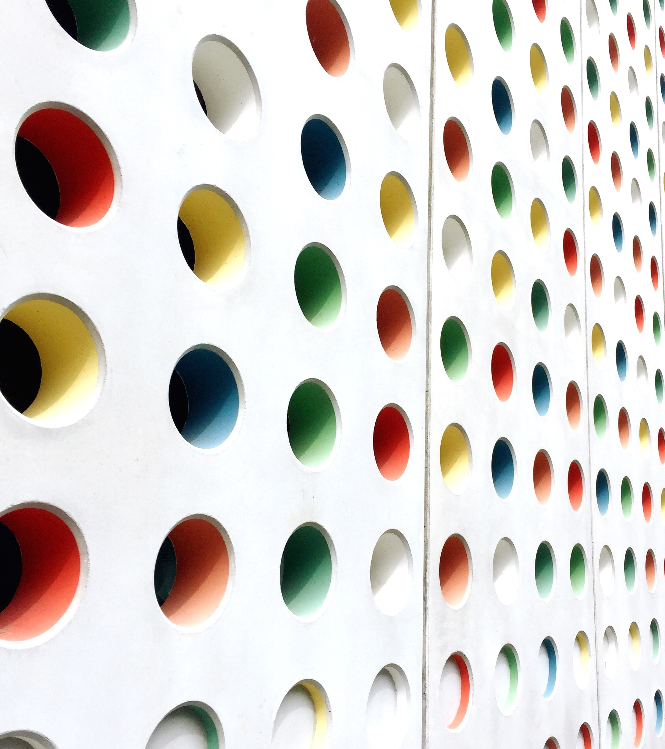
Fornax vs Karmada (and KubeFed/Global-Scheduler)

Slide 2

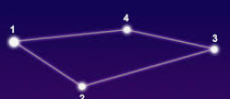
Use Scenarios
FORNAX
Data Center environment
Reliable power/network connections
Edge scenarios
unreliable power/network connections

Slide 3
Cooperating vs Autonomous
FORNAX
Member clusters cooperates to fulfil a work
Each edge cluster works independently

Slide 4
Topology
FORNAX
One host cluster with multiple member cluster connected
No cascading
Flexible & Allows cascading
One-layer is a special case

Slide 5
API Interface of Up-Cluster to Down-Cluster
FORNAX
List/watch based
Based on KubeEdge. Could be:
List/watch based
Websocket-based or QUIC-based (better performance when network conditions are bad)

